Slide 1
Image Saliency Prediction
Amritpal Singh, 2017csb1068
Shivam Prasad, 2017csb1108

Slide 2
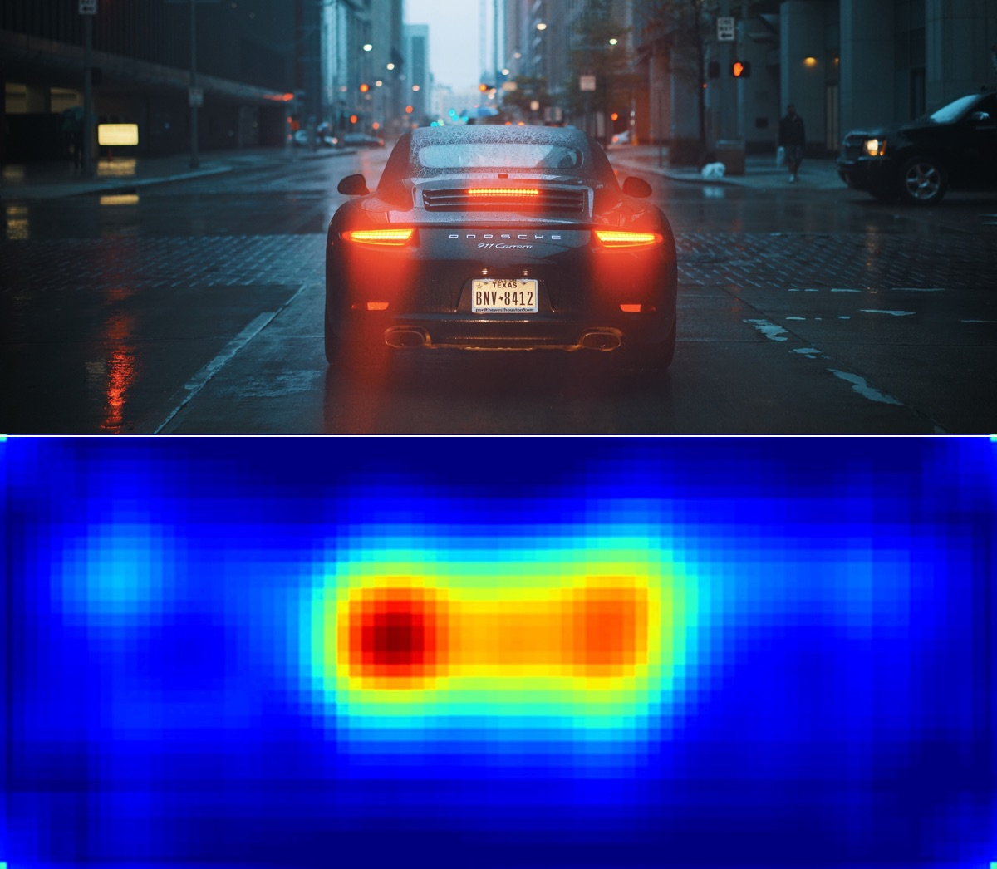
What is Image Saliency
Saliency describe the spatial locations in an image that attract human eye gaze.
The quality which makes some items in the world stand out from their neighbors and immediately grab our attention

Slide 3
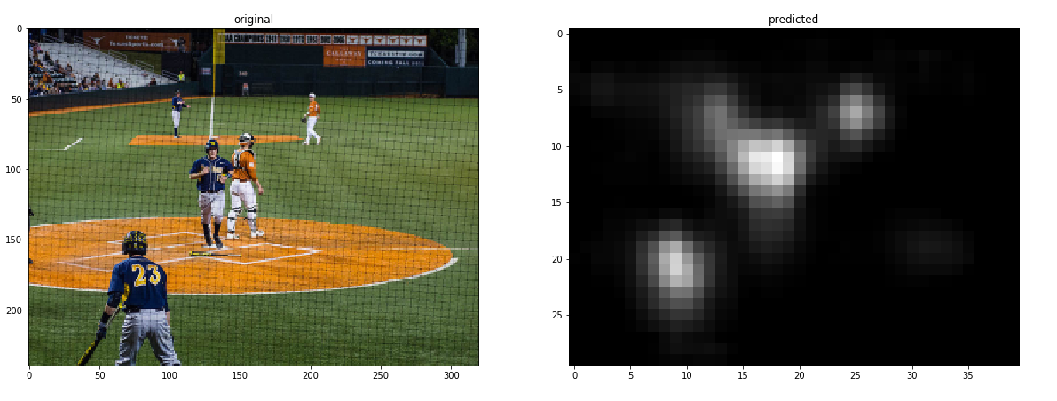
Saliency Maps

Slide 4
Datasets
1. Salicon
Large Dataset of scaled images, 10K train, 5K test, 5K validation
2. MIT 300
Benchmark data set containing 300 natural images with eye tracking data from 39 observers

Slide 5
Methodologies we tested:
1) cv2.saliency.StaticSaliencySpectralResidual_create(): is effective mostly for images with human subjects. Based on ‘ Human detection using a mobile platform and novel features derived from a visual saliency mechanism. ‘ This method is not able to produce effective results when there are multiple regions of interest in the image.
2) Deeply Supervised Salient Object Detection with Short Connection: Produced highly competitive results for images with a single subject or a closely situated group of subjects, but failed in cases where the image has no person/animal and is a scene or a perspective.
3) We tried to get SALGAN( LSUN’17 saliency prediction challenge winner) running but it had very high hardware requirements.

Slide 6

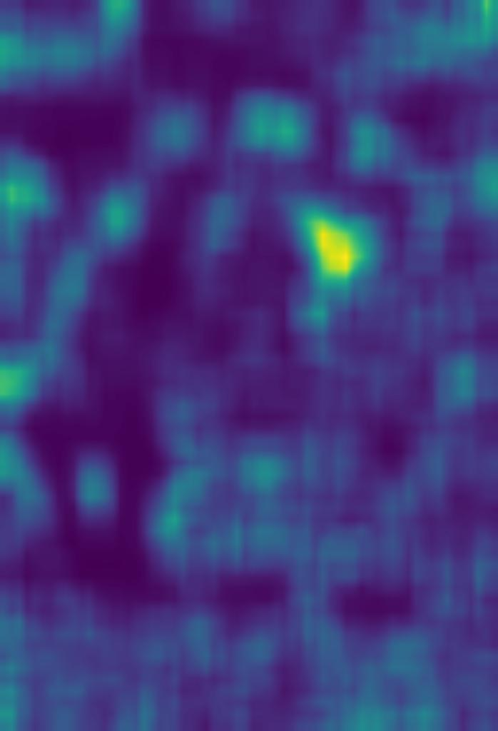
OpenCV
Has a function callable as : cv2.saliency.StaticSaliencySpectralResidual_create()

Slide 7
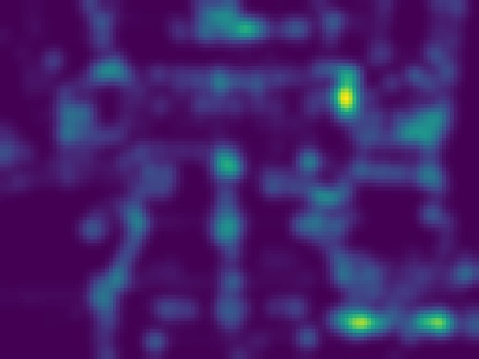

A Corner-based Saliency Model- Wirawit Rueopas

Slide 8
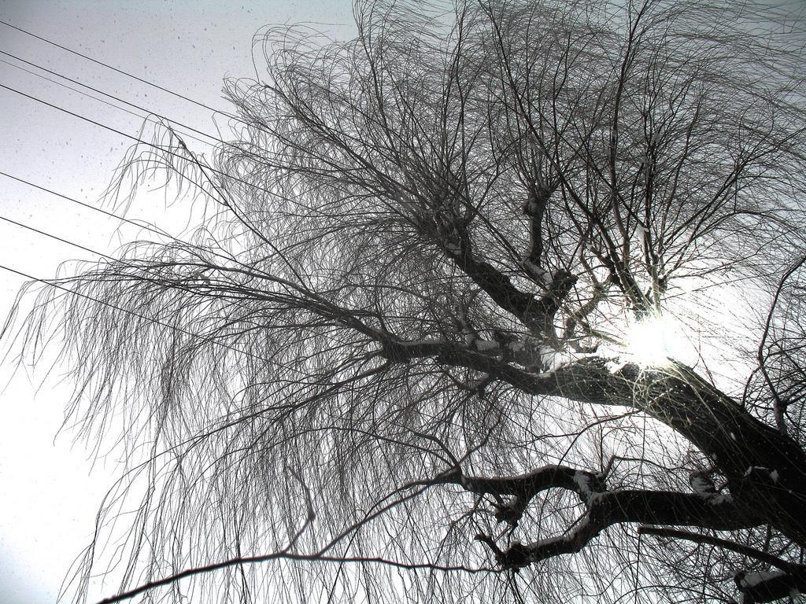
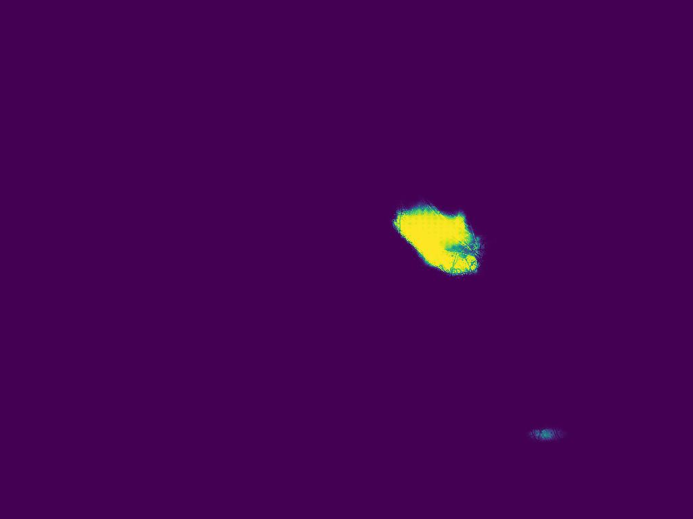
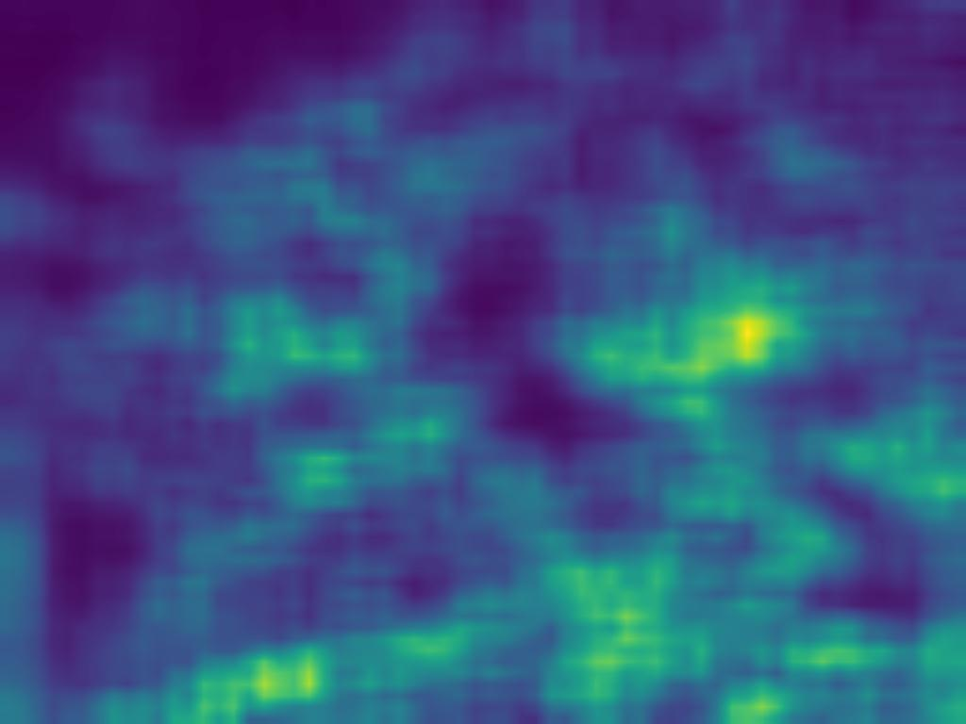
Original
DSSNet prediction
OpenCV prediction

Slide 9
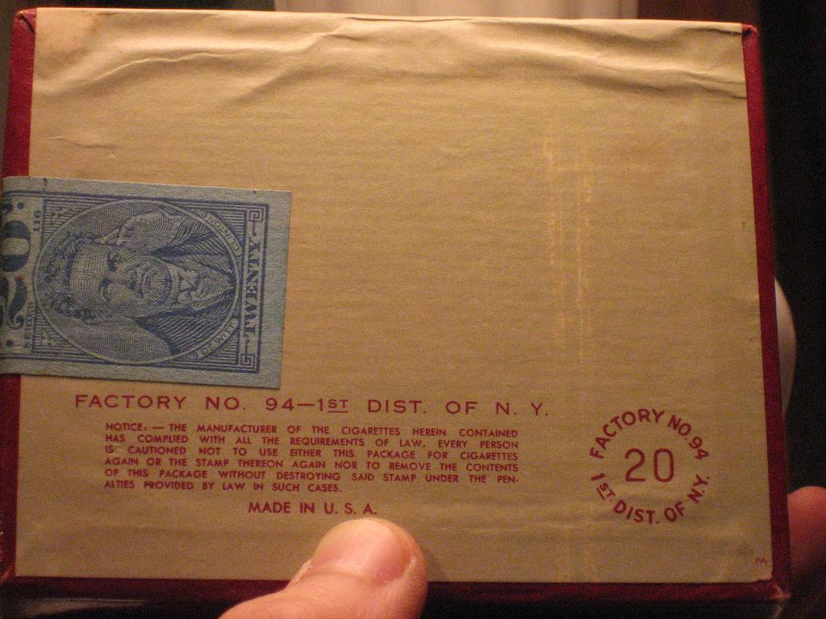
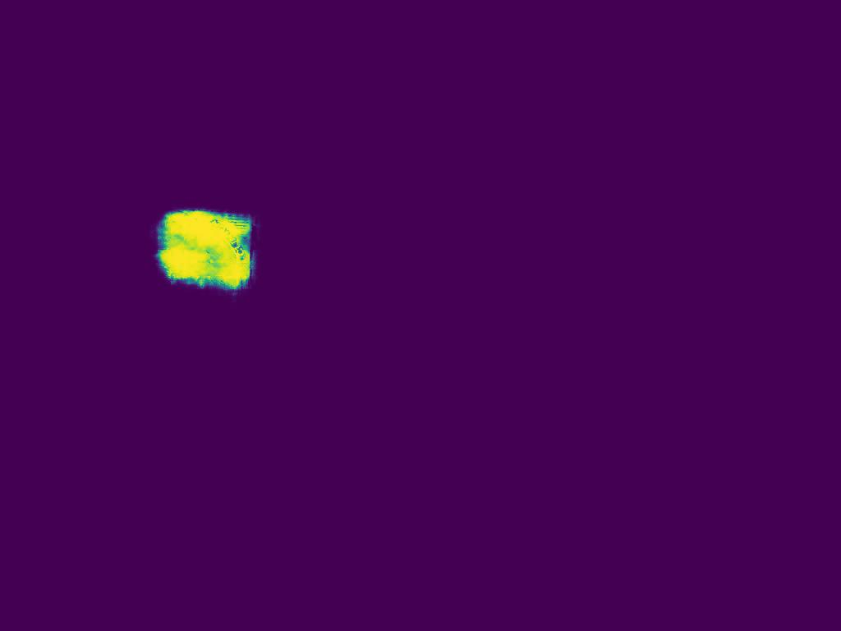
BUT...

Slide 10
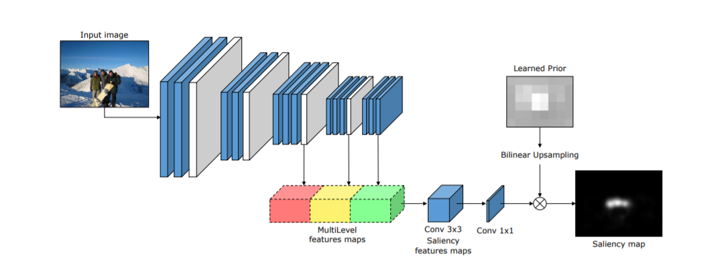
The Deep Multi-Level Network
Reference
Cornia, Marcella, et al. "A deep multi-level network for saliency prediction." Pattern Recognition (ICPR), 2016 23rd International Conference on. IEEE, 2016.

Slide 11
Methodology
VGG-16: Simple and generalisable architecture, but reduces the size of feature maps considerably at higher levels.
To reduce the decrease in size of the feature maps, the last max pooling layer has been removed and the second last max pooling layer has a reduced stride size. This results in feature maps of size (w/8)*(h/8) finally.
Feature maps produced at 3 different stages are concatenated to get a tensor which finally learns 64 saliency-specific feature maps with a 3 × 3 kernel in a convolutional layer.

Slide 12
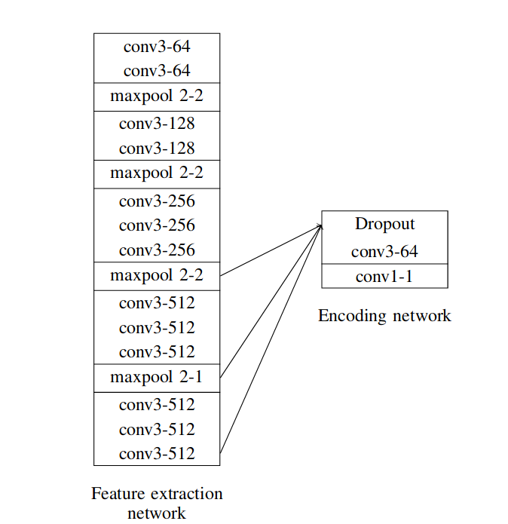
Final Network

Slide 13
Methodology continued..
4. Loss Function: This is based on 3 objectives
predictions should be pixel-wise similar to ground truth maps, therefore a square error.
Predicted result should be normalized.
The loss should give the same importance to high and low ground truth values.

Slide 14
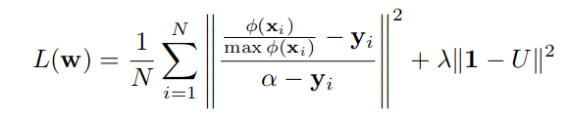
Methodology continued..
A. xi is our predicted map
B. yi is Ground truth
C. U is prior
D. Lamda is L2 regularization term

Slide 15
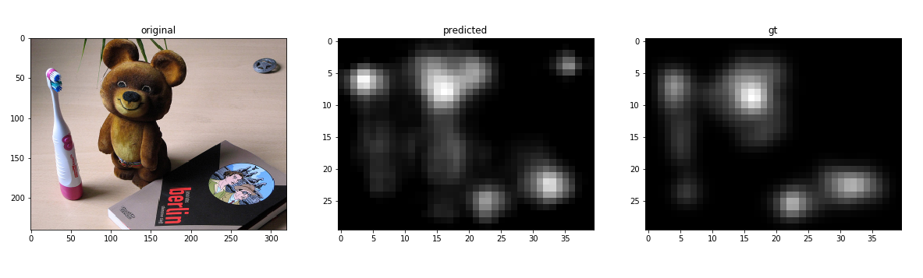
Outputs

Slide 16
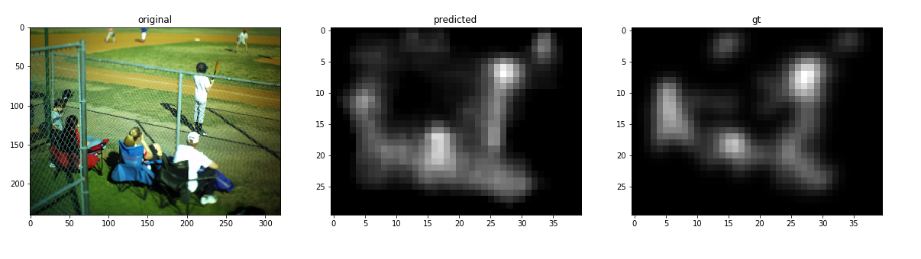
Outputs

Slide 17
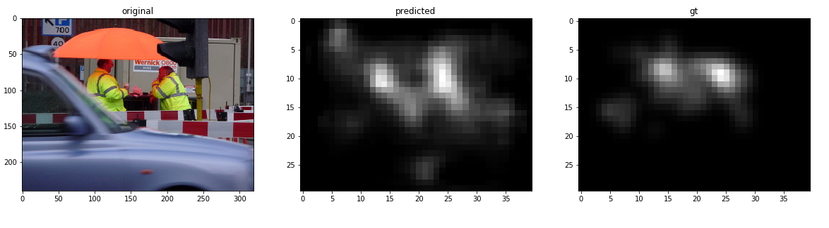
Outputs

Slide 18
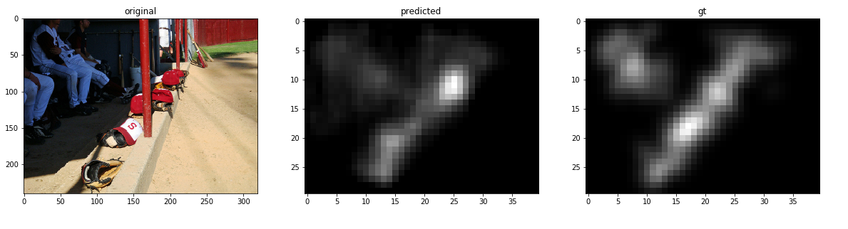
Outputs

